Slide 1
Prayers of the People
Words & Music – Rev. Ben Johnston Krase
Photos – David Young & Corey Nelson

Slide 2
We are praying, oh we are praying.
We are praying, oh we are praying
We are man, woman
we are children
and oh – we are praying
Let the rains go, let the healing river flow,
let justice roll like water
Let the day begin when new life enters in
and let your Kingdom come.

Slide 3
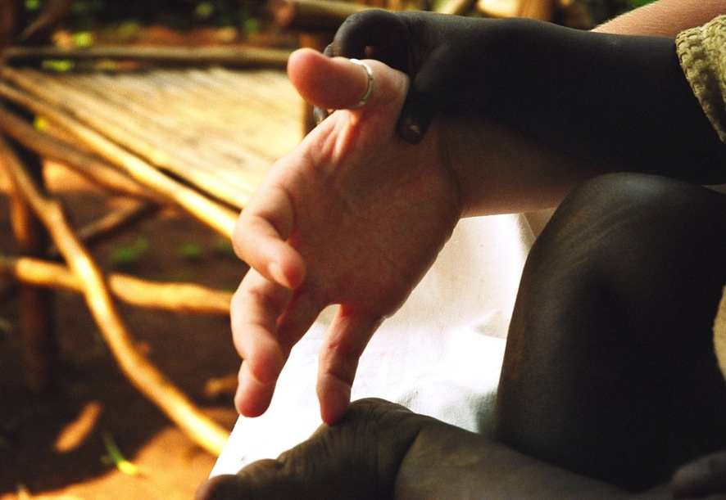
We are praying, oh we are praying

Slide 4
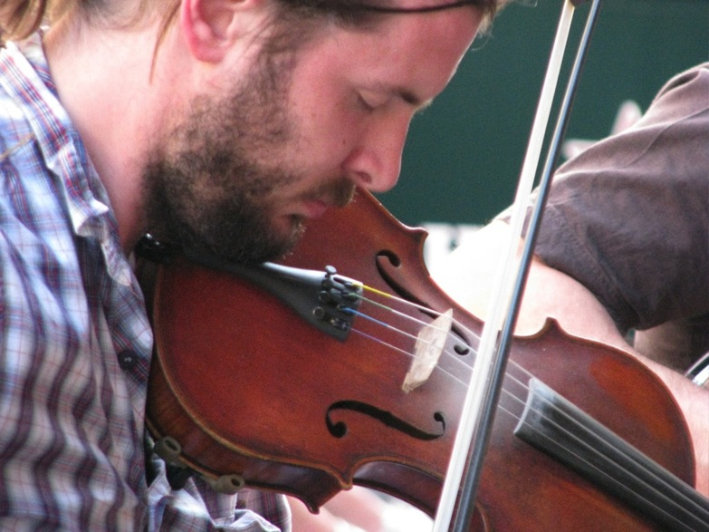
We are praying,
oh we are praying.

Slide 5
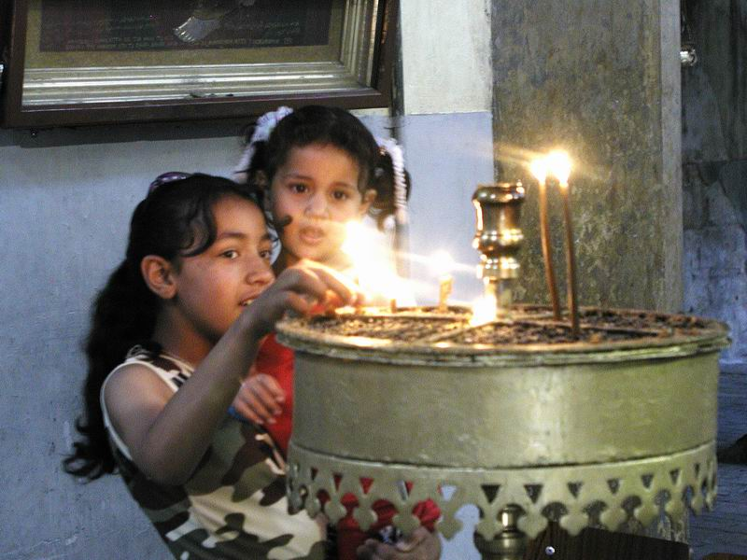
We are man, woman, we are children
and oh, we are praying

Slide 6
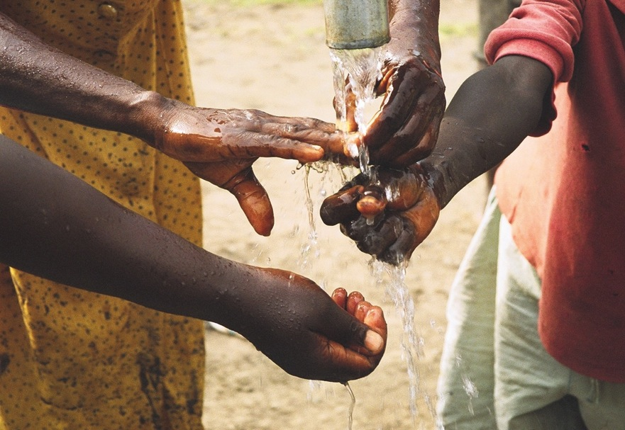
Let the rains go, let the healing river flow,
let justice roll like water

Slide 7
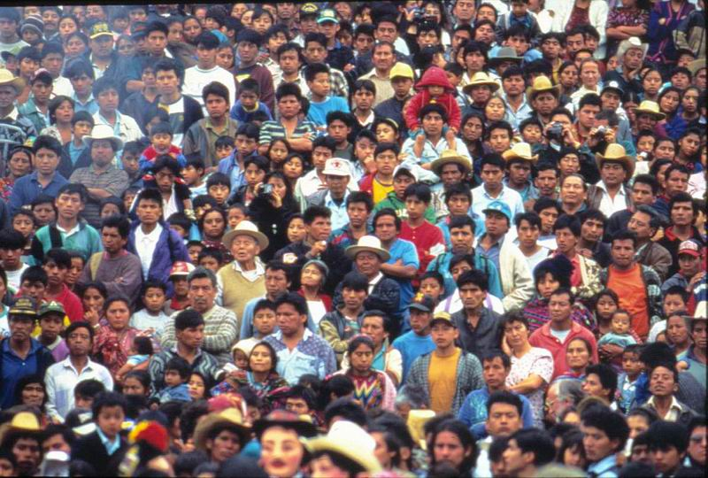
Let the day begin when new life enters in and let your Kingdom come.

Slide 8
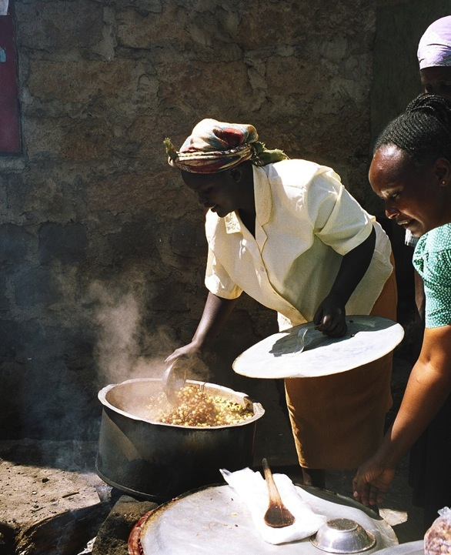
We are hungry
oh, we are hungry

Slide 9
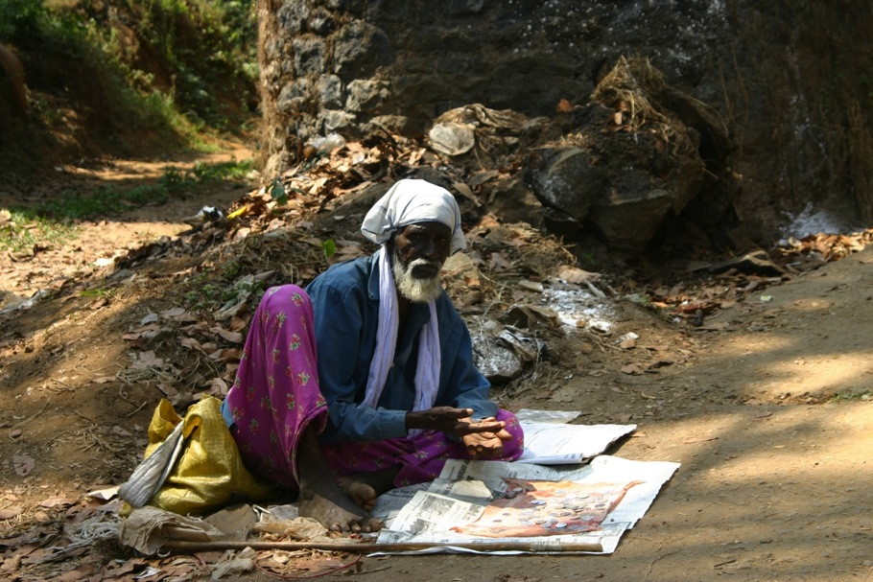
We are hungry, oh we are hungry

Slide 10
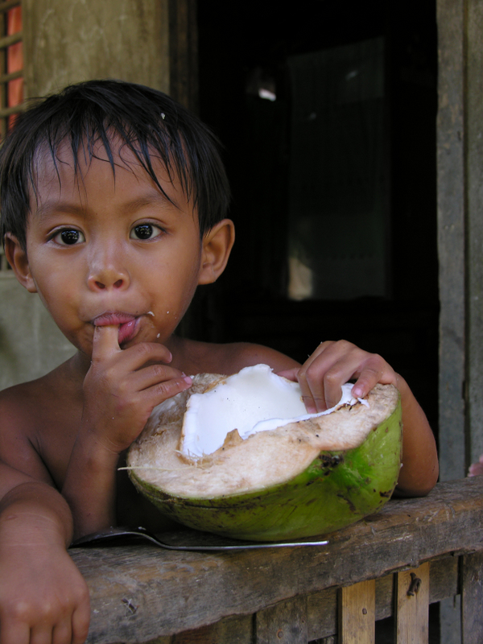
We are man, woman, we are children
and oh
we are hungry

Slide 11
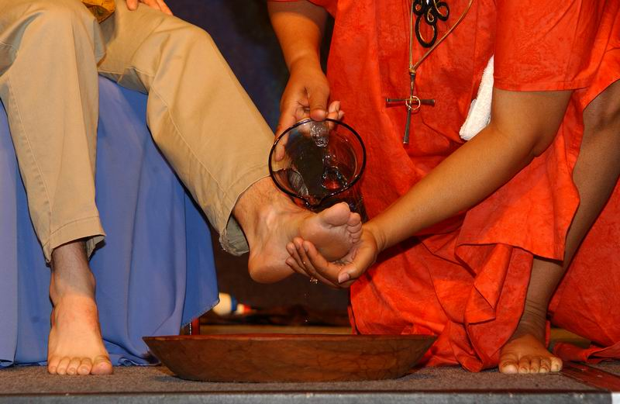
Let the rains go, let the healing river flow,
let justice roll like water

Slide 12
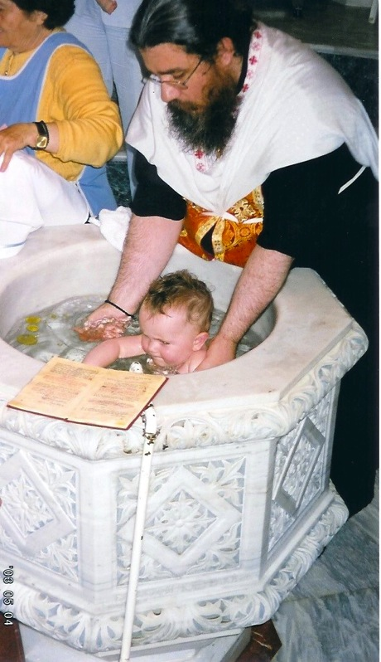
Let the day begin when new life enters in
and let your Kingdom come.

Slide 13
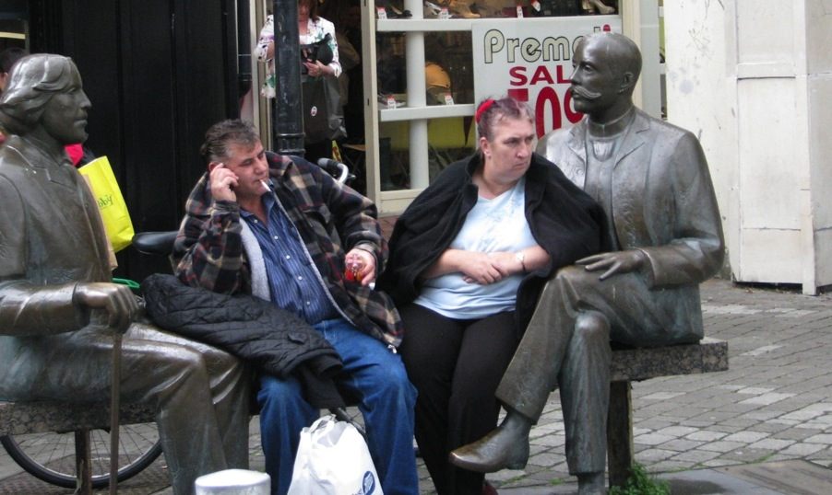
We have are homeless
Oh, we are homeless

Slide 14
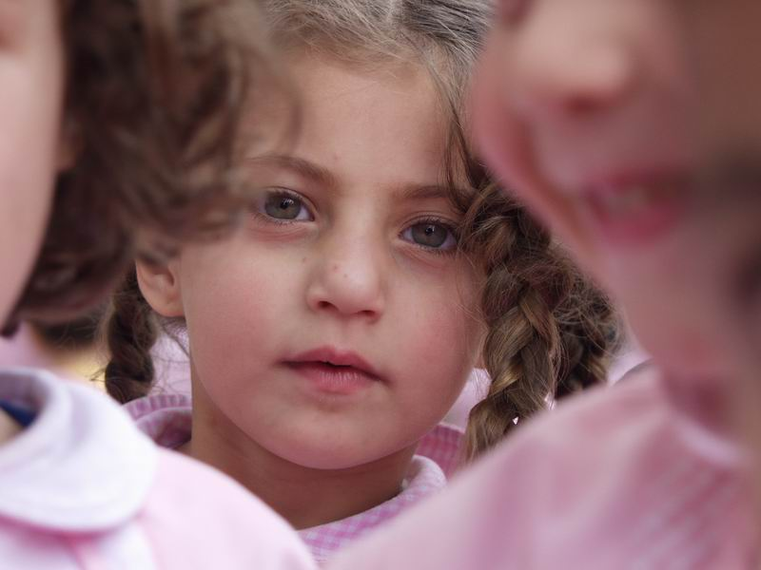
We have are homeless
Oh, we are homeless

Slide 15
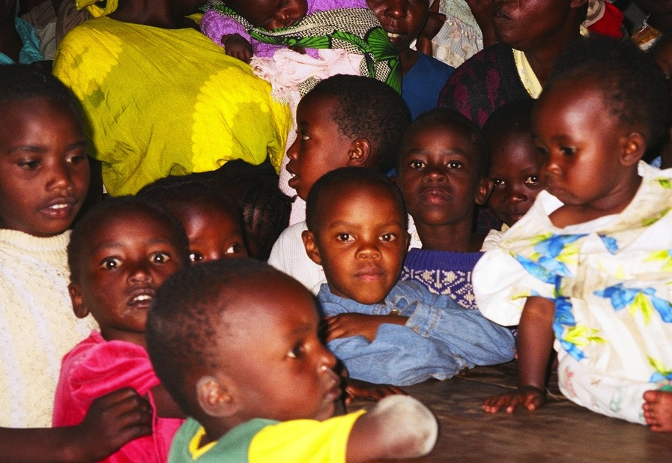
We are man, woman, we are children and oh, we are homeless

Slide 16
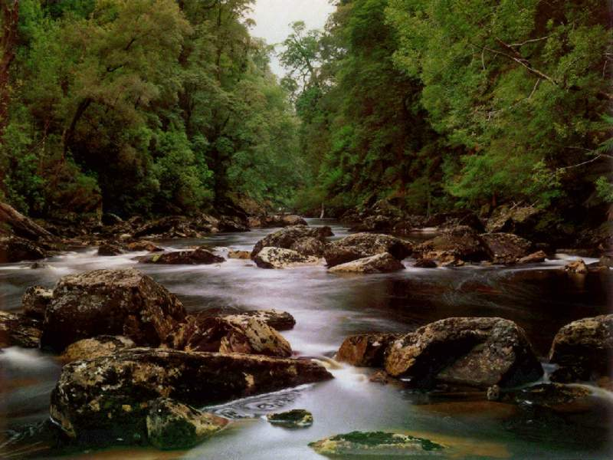
Let the rains go, let the healing river flow,
let justice roll like water

Slide 17
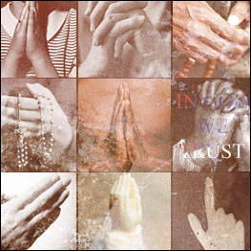
Let the day begin when new life enters in and let your Kingdom come.

Slide 18
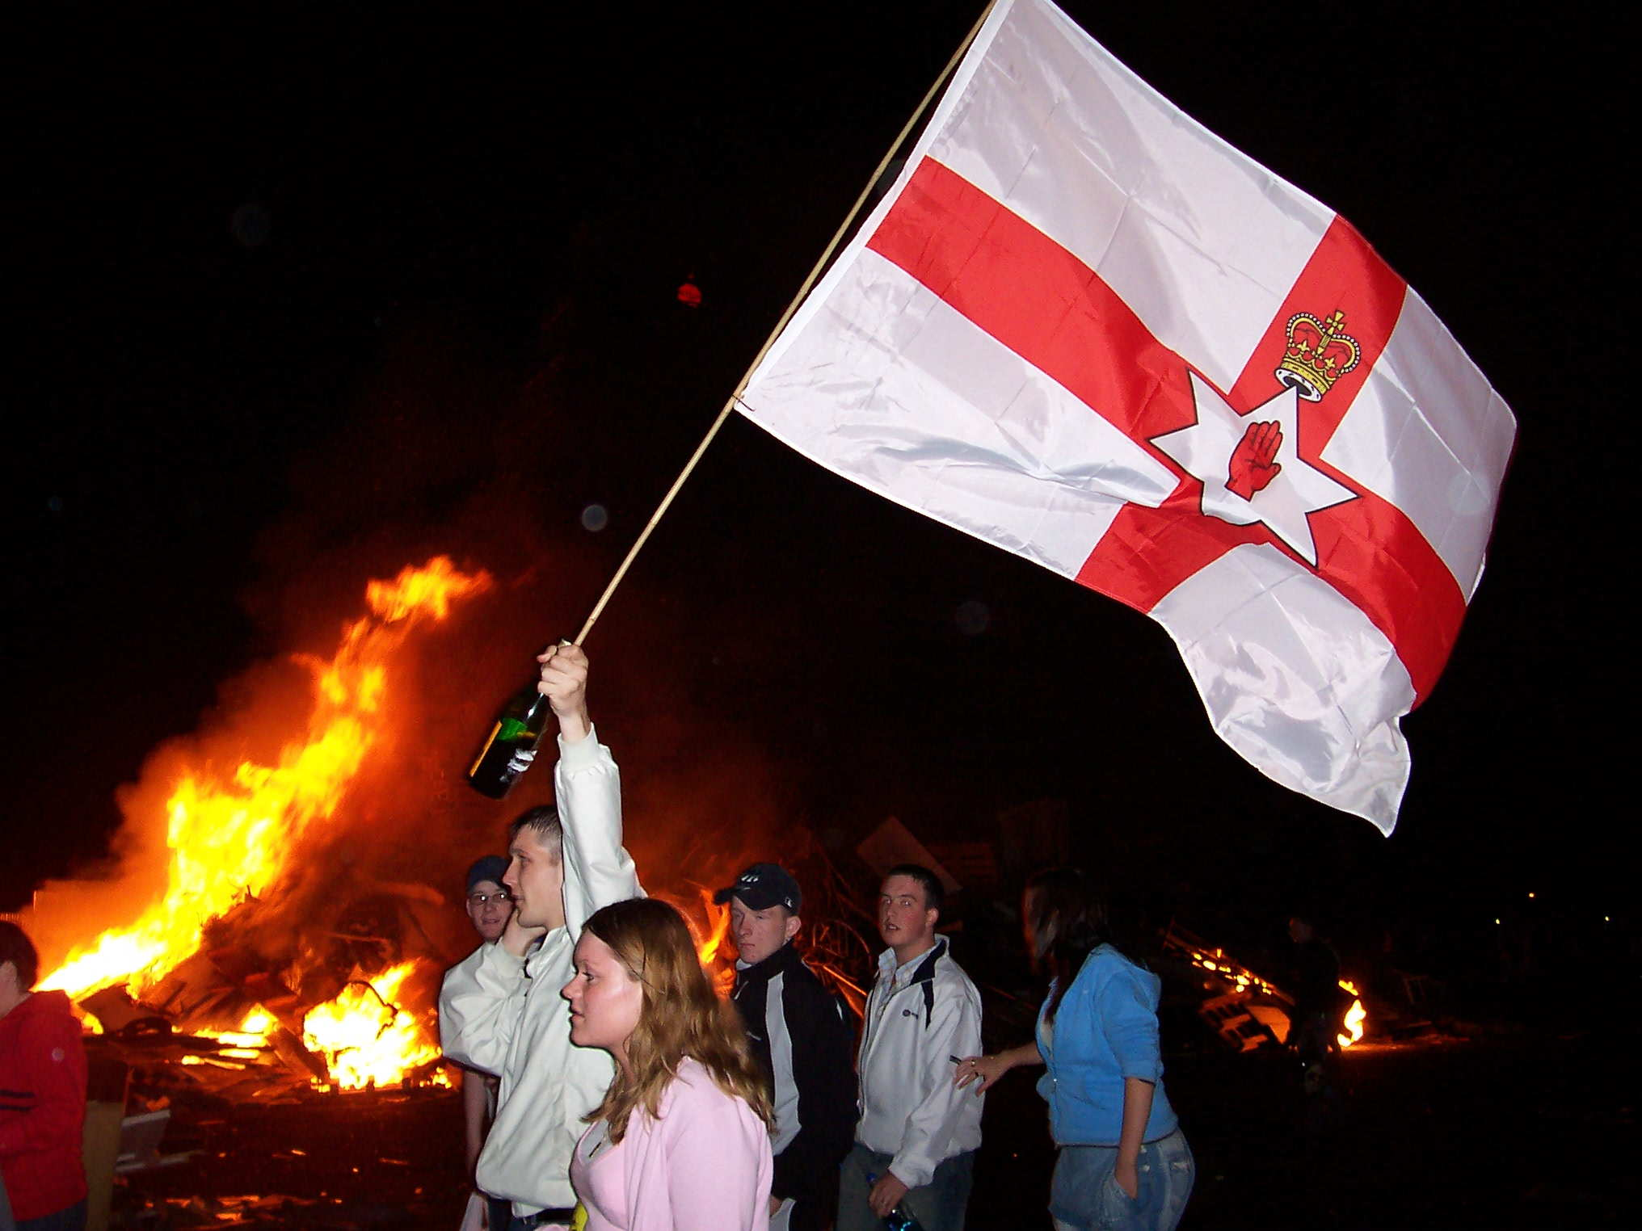
We are fighting oh we are fighting

Slide 19
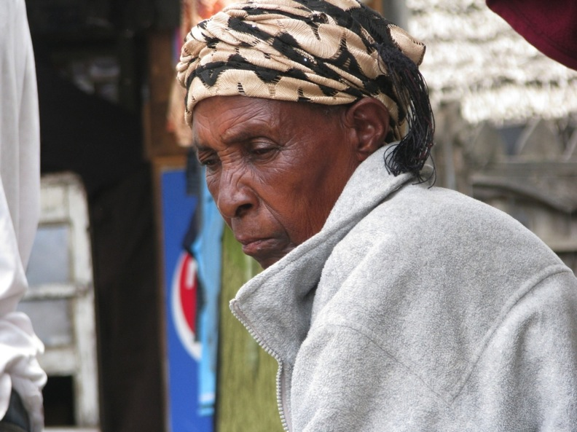
We are fighting oh we are fighting

Slide 20
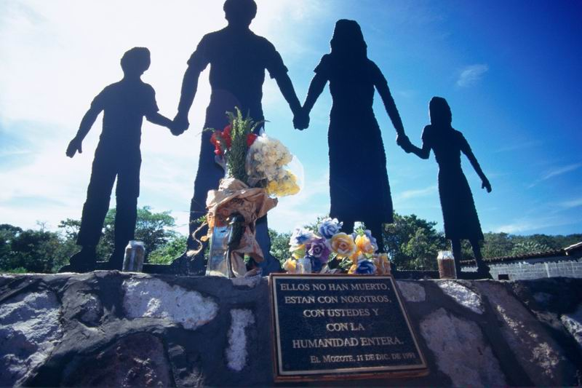
We are man, woman, we are children,
and oh we are fighting

Slide 21
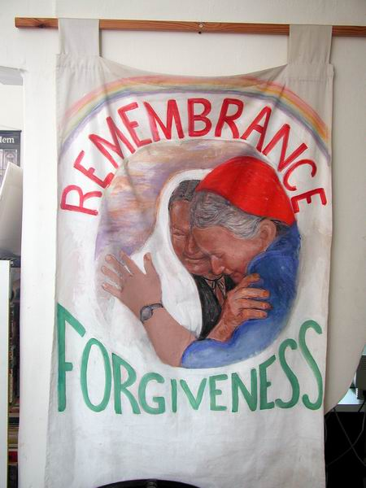
Let the rains go,
let the healing
river flow
let justice
roll like water

Slide 22
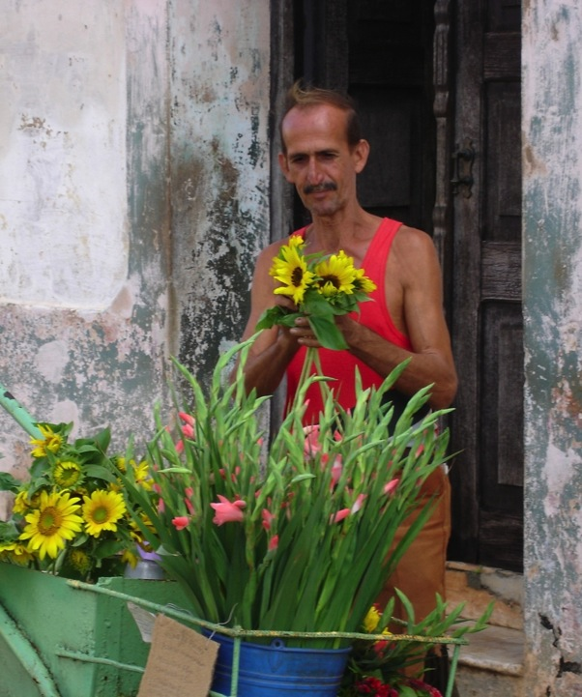
Let the day begin when new life enters in
and let your Kingdom come.

Slide 23
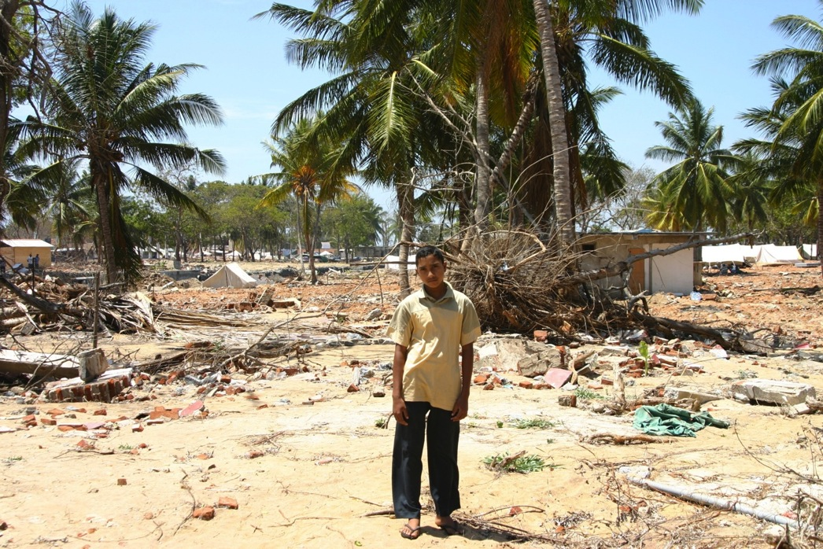
We are crying, oh we are crying

Slide 24
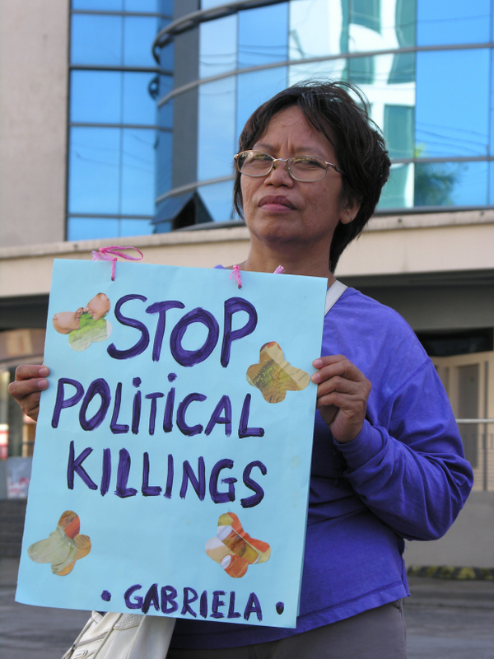
We are crying,
oh we are crying

Slide 25
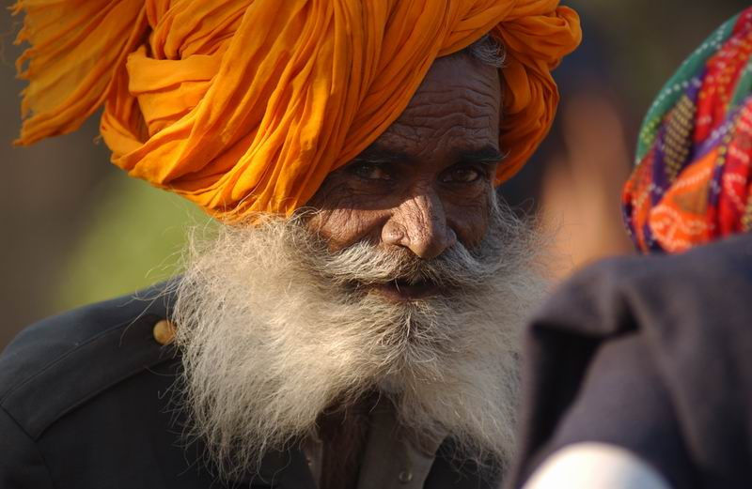
We are man, woman, we are children,
and oh we are crying

Slide 26
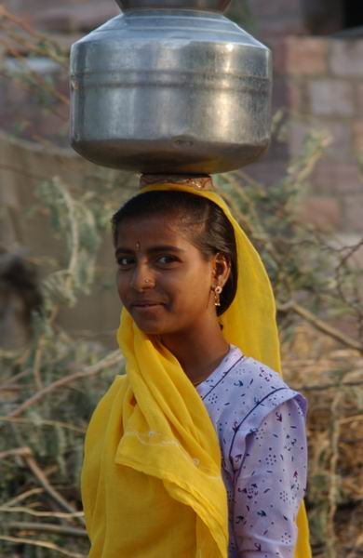
Let the rains go
let the healing
river flow
let justice roll
like water

Slide 27
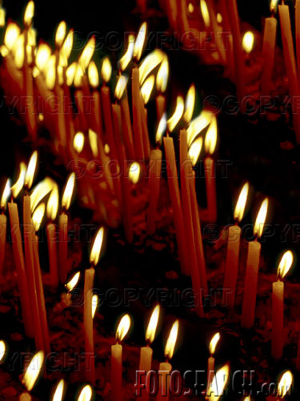
Let the day begin
when new life
enters in
and let your Kingdom come.

Slide 28
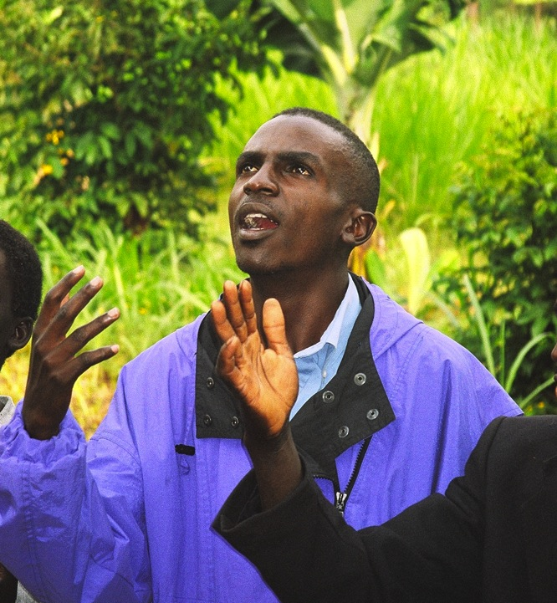
We are singing oh we are singing

Slide 29
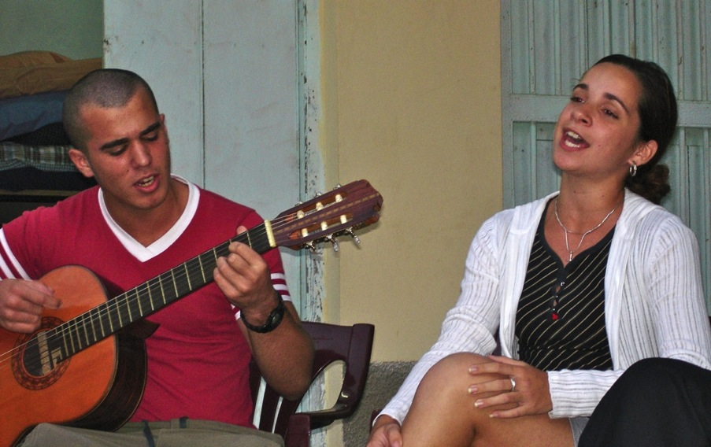
We are singing oh we are singing

Slide 30
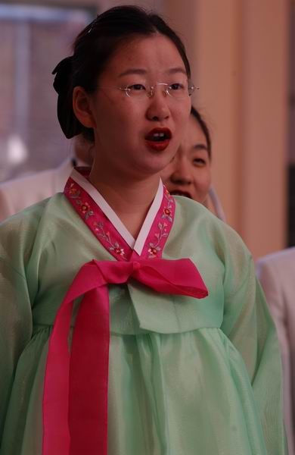
We are man, woman,
we are children
and oh
we are singing

Slide 31
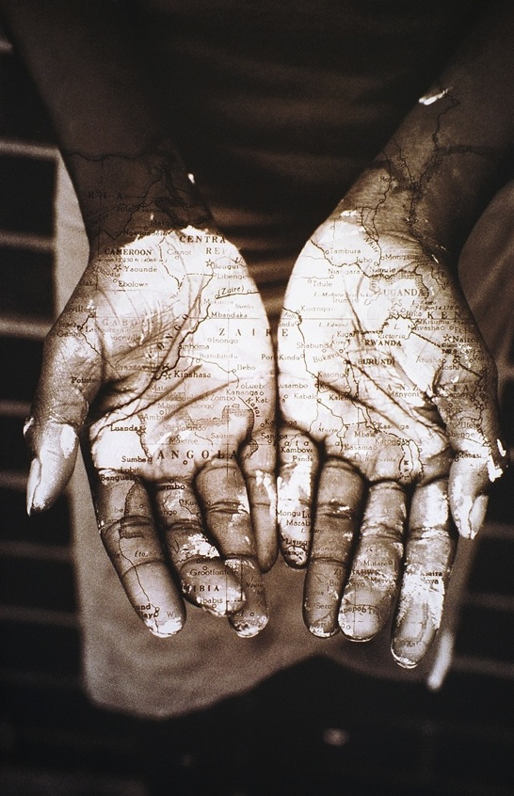
Let the rains go
let the healing
river flow
let justice roll
like water

Slide 32
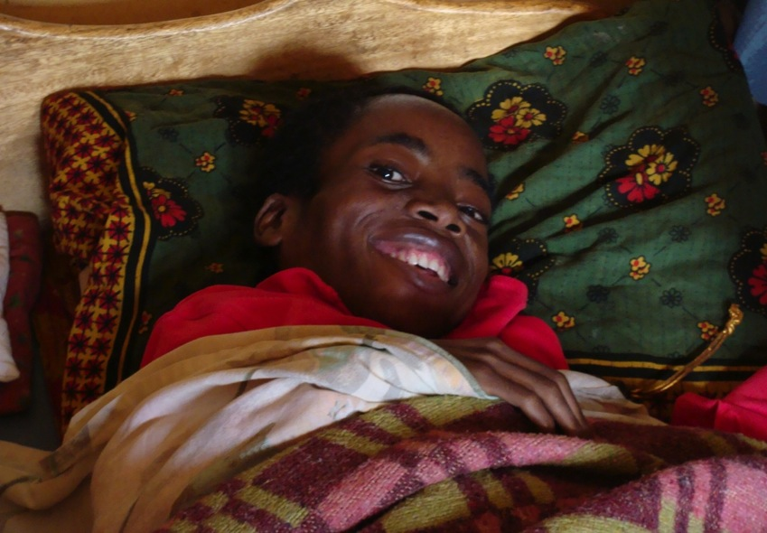
Let the day begin when new life enters in and let your Kingdom come.

Slide 33
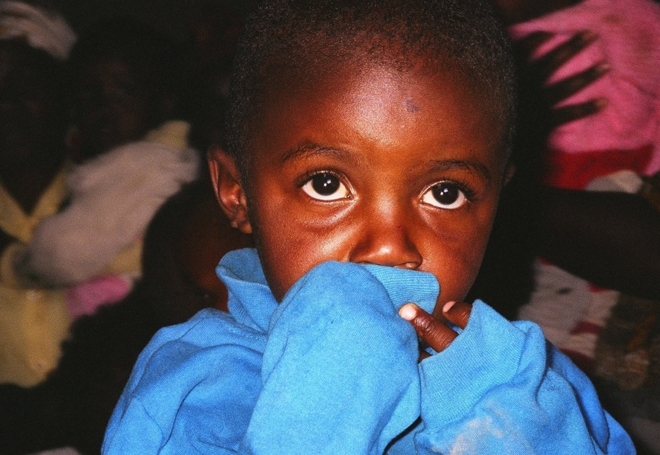
Let your kingdom come – Let your kingdom come

Slide 34
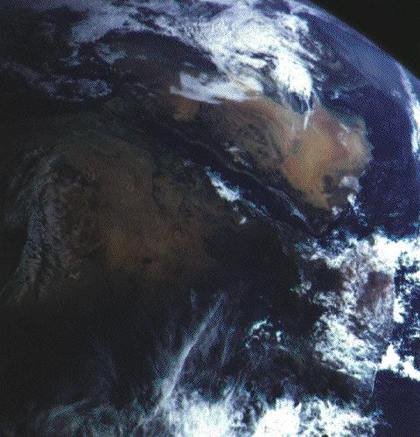
Amen

